Slide 1
Business Presentation

Slide 2
Contents
Business Problem Overview and Solution Approach
Data Overview
EDA
Model Performance Summary
Model Performance Comparison and Conclusions
Business Insights and Recommendations

Slide 3
Business Problem Overview and Solution Approach
Core business idea
A significant number of hotel bookings are called off due to cancellations or no-shows. The typical reasons for cancellations include change of plans, scheduling conflicts, etc. Idea is to reduce room cancel thereby improve the overall sales.
Problem to tackle
Identify deficiencies in current target segmentation.
Identifying potential cancelations
Financial implications
Last minute cancellations that impact the hotel sales and resources
How to use ML model to solve the problem
Logistic Regression and Decision Trees have been used to predict the model that can be implemented to predict the bookings that are likely to be canceled.

Slide 4
Data Overview
The data contains information about 56926 customer bookings of Star Hotels and their characteristics
The characteristics include no_of_children, number_of_adults, no_of_weekend_nights, no_of_week_nights, type_of_meal_plan, required_car_parking_space and many more. There are 18 such characteristics.
Some rows are duplicates. Hence, the duplicate rows have been removed resulting in 42576 rows.
Booking_status has been changed from object to numerical variable.
object variables like type_of_meal_plan has been changed to categorical.
There are no missing values.
Factors like Lead time, average price per room, no of special requests, market segment type and many more can affect the cancellations.

Slide 5
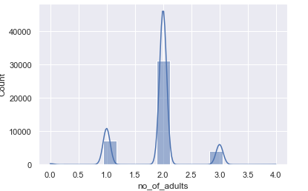
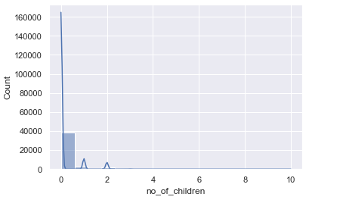
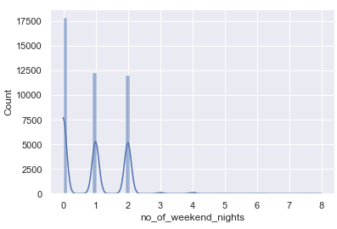
EDA – no_of_adults, no_of_children, no_of_weekend_nights
Number of adults is 2 in most of the cases.
In most of the cases Number of children = 0.The distribution is positively skewed. There are 5 outliers.
Most of the booking are made for 1-2 weekend nights. There are 3 outliers.

Slide 6
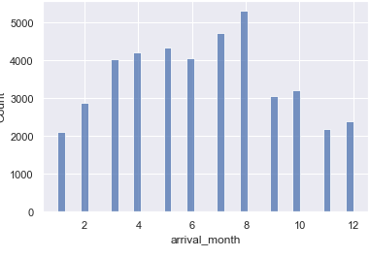
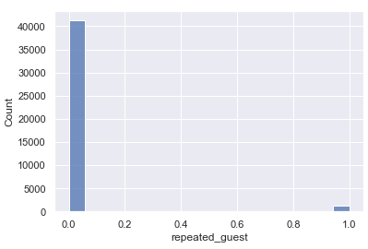
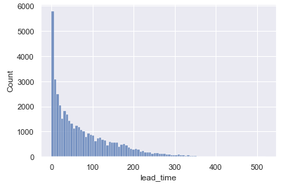
EDA - lead_time, arrival_month, repeated_guest
Lead_time → The distribution is positively skewed.
There are many outliers.
Most of the booking are in August month.
The least number of bookings are in January and November
Most of the customers are repeated guest.

Slide 7
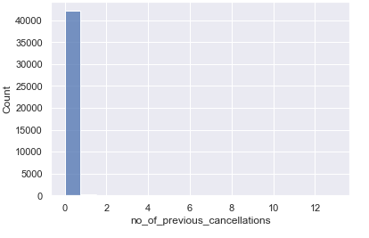
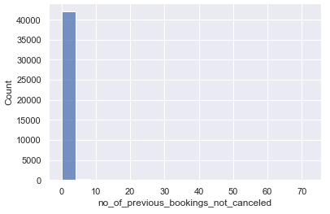
EDA - no_of_previous_bookings_not_cancelled, no_of_previous_cancellations
Most of the customers have zero previous cancelations.
Number of previous bookings not canceled is 0 in most of the cases

Slide 8
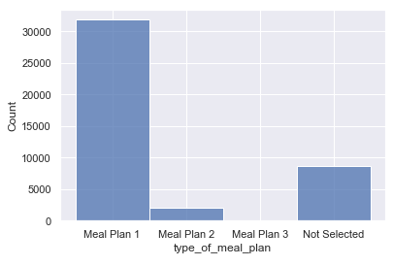
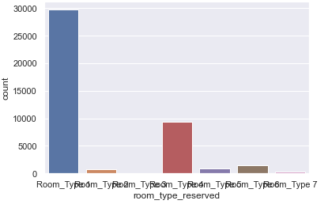
EDA – Categorical Variables --Meal_plan and room_type
Maximum number of the customers prefer Meal Plan 1. There are some customers who dont have any preference.
Most of the customers prefer Room Type 1. Least preferred room is Room Type 3 followed by Room Type 7.

Slide 9
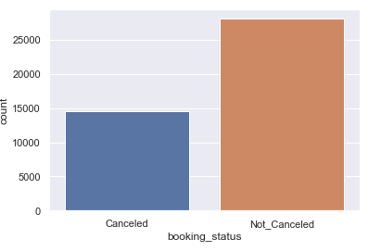
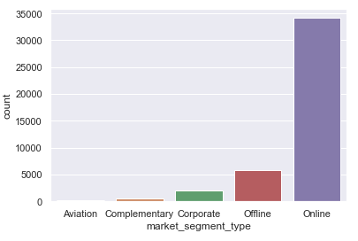
EDA–market segmentation type and booking status
Most of the customers prefer 'online' market Segmentation type. Least preferred is Aviation.
Most of the customers have not canceled their booking.
BiVariate Analysis – (Heat_map)
Number of previous cancelations show high correlation with number of previous bookings not canceled (0.58)
Repeated guest show high correlation with number of previous bookings not canceled(0.56)
It is important to note that correlation does not imply causation.
There are some negatively correlated.

Slide 10
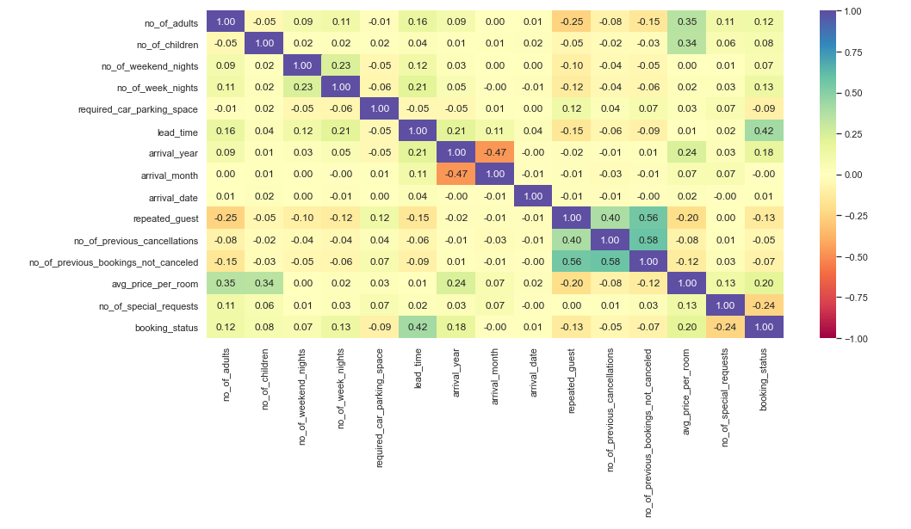
BiVariate Analysis(Heat_Map)

Slide 11
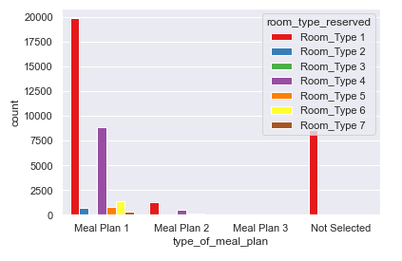
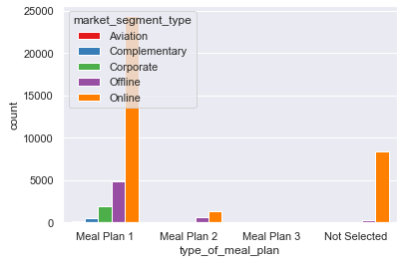
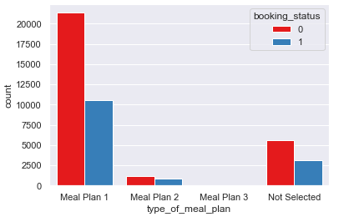
EDA – meal_plan vs room_type, market_segment and booking_status
Room type 1 is mostly preferred followed by Room type 4 . Customers who prefer Meal Plan 1 mostly use Room type 1.
Most of the customers prefer Meal Plan 1. Mean plan 1 customers prefer online market segment type. Customers who have not selected any meal plan prefer online market segment type.
Customers who prefer Meal Plan 1 have more cancellations than other meal plan groups.

Slide 12
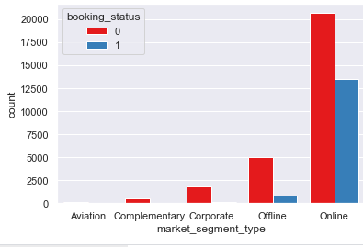
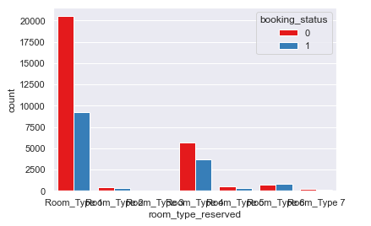
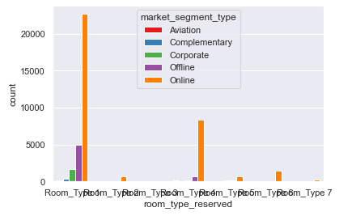
EDA - room_type, market_segment and booking_status
Customers prefer Online market segment type. Most of the customer choose Room Type 1 and online market segment type.
It is observed that customers who prefer Online market segmentation had more cancellations than others. There are more customers with booking status is not canceled.
Customers who prefer Room type 1 had more cancellations than other.

Slide 13
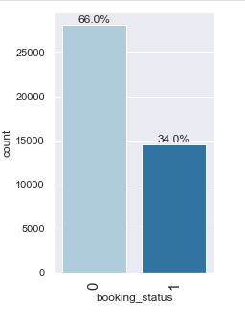
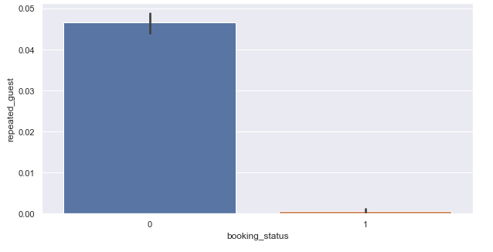
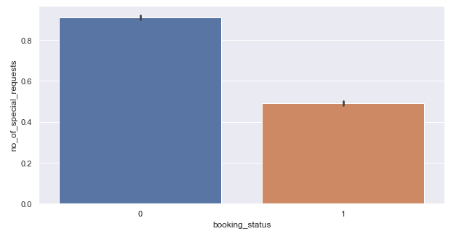
EDA (Contd)
34% of the bookings are cancelled.
The rest of the 66% of the bookings are not canceled.
More that 97% of the repeating guests donot cancel the bookings.

Slide 14
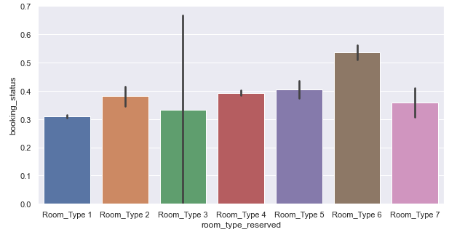
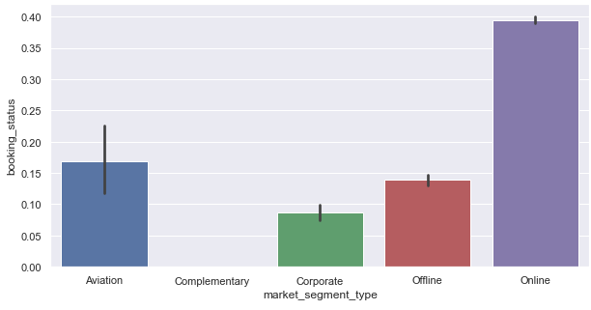
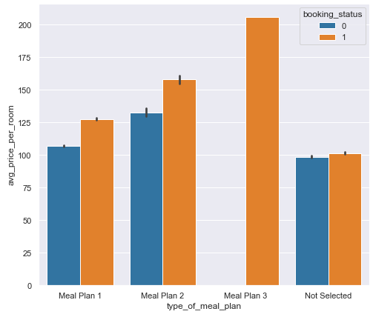
EDA(Contd)
Average price of the room if the customer chooses Meal Plan 3 and booking status is cancelled is most expensive. The customer whose booking status is not cancelled and if he chooses Meal Plan 1, the average price of the room will be lesser.
Max number of cancelations are seen when Room Type 6 is chosen.
Max number of cancelations are seen form market segment type is Online and least for market segment type is Complementary.

Slide 15
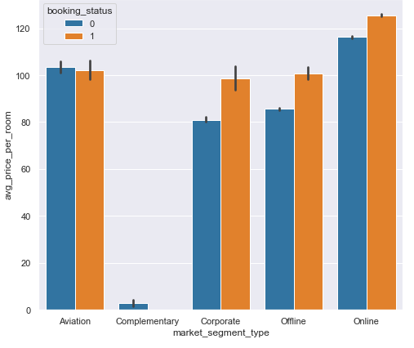
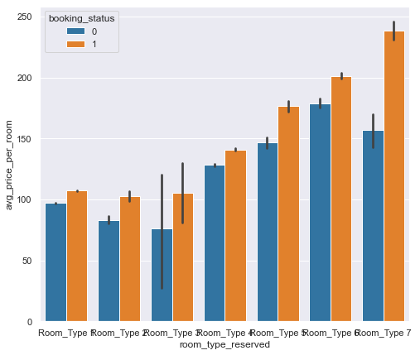
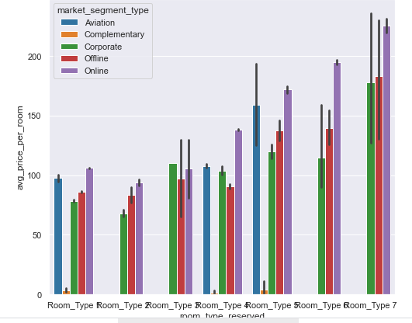
EDA(Contd.)
For all kinds of room types, there are more cancelations than non Canceled rooms.
Room Type 7 is most expensive for all types of market segmentation
Room Type 2 is cheaper for all types of market segmentation

Slide 16
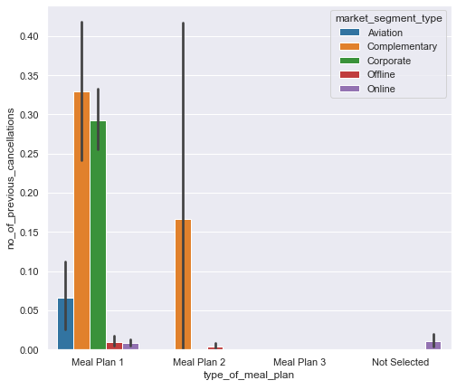
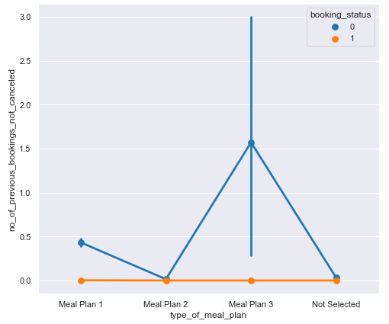
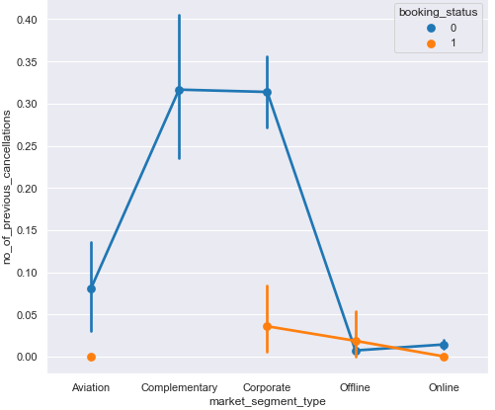
EDA(Correlation)
Number of previous cancelations is least for all the Market Segments if the booking status is canceled.
Number of previous bookings not canceled is most for Meal Plan 3 and booking status is not canceled.
Number of previous bookings not canceled is least for booking status is canceled for all the meal plans.
Number of previous cancelations is least for market segment type is online and offline for all the meal plans.
Number of previous cancelations is highest for market segment type is Complementart and Corporate for Meal PLan 1

Slide 17
EDA - Summary
Most of the customers prefer Meal Plan 1, followed by Mean plan 2. Rest of customers who have not selected a meal preference.
There are least cancellations in Meal plan 3. Cancellations are highest in Meal plan 2.
Most preferred room type is 1. followed by type 4, type 6 and 5. Least preferred room type is type3 followed by 7.
Percentage of cancellations is high in type 6. There are no cancellations in type 7 and 3.
Most of customers are online bookers followed by offline and coroprate. Least is aviation.
There are no cancellations in market segment type - Aviation, complementary and corporate.
Very few cancellations in offline segment. However, close to 65% cancellations in online segment.

Slide 18
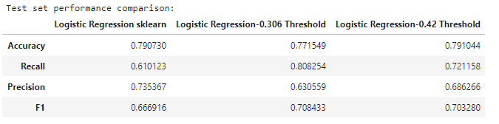
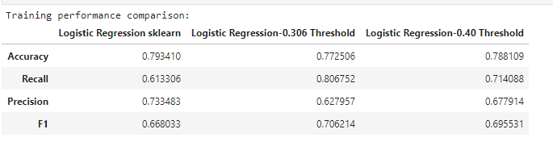
Model Performance Summary
Logistic Regression and Decision trees were used to implement Machine Learning techniques
Factors Accuracy, Recall, Precision and F1 values are calculated and compared to find the best model.
Logistic Regression

Slide 19



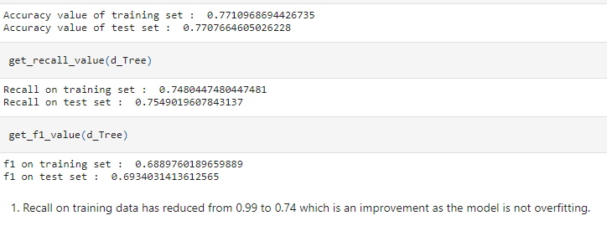
Decision Tree - StatsModel
Decision Tree -with depth limited to 3

Slide 20
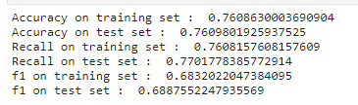
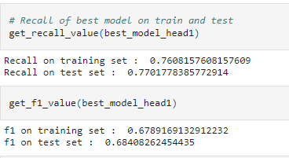

Decision Tree -Best Model
Decision Tree -Hyperparameters

Slide 21
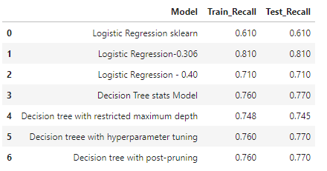
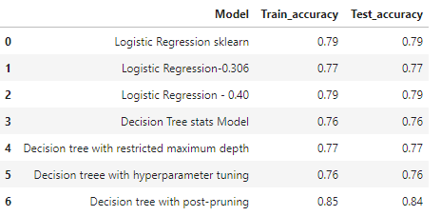
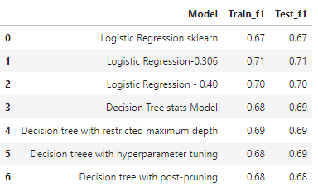
Model Performance Comparison and Conclusions

Slide 22
Model Performance Comparison and Conclusions
According to the Recall definition, high recall means less false negatives. Lower chances of predicting the cancelation as non-cancelation. Recall should be maximized, the greater the Recall higher the chances of identifying.
Here, the highest recall value is obtained for Logistic Regression Stats Model - 0.306 Threshold.
The highest accuracy value is obtained for Decision tree with post-pruning
The difference between recall values for Logistic Regression Stats Model - 0.306 Threshold and Decision tree with post-pruning is 4%. The value of recall for Logistic Regression Stats Model - 0.306 Threshold is only slightly more.
The Decision tree with post-pruning has highest accuracy 0.84 and recall value is 0.77. This tree with post pruning is not complex and easy to interpret.
The Decision tree with post-pruning is preferred.

Slide 23
Business Insights and Recommendations
The following attributes play major role in cancellations.
1. Lead time,
2. average price per room,
3. no of special requests,
4. market segment type online
Bookings with high lead time have high cancellations. Lead time > 150 are likely to be cancelled.
Bookings with high Average price per room are likely to be cancelled. Average price per room > 100 are likely to be cancelled.
If Lead time is < 150, # special requests <= 0.5 and booking is online then it is likely to be cancelled.

Slide 24
Business Insights and Recommendations
Special attention should be paid to online bookings. Analyze further to see if these online bookings being cancelled are from same customer or agency.
These could be double bookings. If such a pattern is identified, we could mark them for pre cancellation and make them available for other customers.
On Bookings with high lead time, try adding a higher cancellation fee. Alternately, disallow bookings more than 150 days in advance.
Make cancellation fee a percentage of the Average price per room so that higher priced rooms are not easily cancellable.
Alter refund policy such that cancellations closer to stay date are disallowed or have a high penalty.
Since percentage of cancellations is high in type 6. Discontinue type 6. Alternately, model type 6 rooms on similar lines as types 7 and 3 as they have least cancellations.

Slide 25
Business Insights and Recommendations
Try to allocate more rooms via corporate tie-ups for - Aviation, complementary and corporate customers as these customers seem more reliable. Increasing sales of these segments will mitigate risk of cancellations in online segment.
Encourage longer weekend nights for hotel bookings as such bookings seem to have least cancellations. Provide special discounts on such packages to entice customers.

